Slide 1

Logic
By Ariel Avshalom
Lecture 3
CISC 2210

Slide 2

What we’ll cover
Chapter 7 of the book: https://www.people.vcu.edu/~rhammack/Discrete/Alpha.pdf

Slide 3
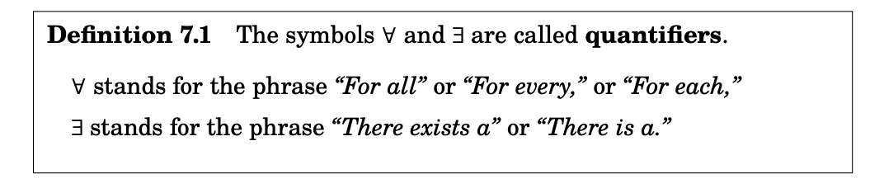

Quantified Statements
$\text{∃}$ - There exists at least one
Example: $\text{∃}\text{x}\text{∈}\text{S}$ such that x is a multiple of 3
In English: There exists an element x in S such that x is a multiple of 3 ℝ.
$\text{∀}$ - For any value
Example: For $\text{∀}$x $\text{∈}$ℕ, x $\text{∈} \text{ℝ}$
In English: For any element x of the natural numbers, x is also an element of the reals..

Slide 4
Examples
Translate into set builders notation (symbolic logic):
For any integer x in the set of 3n+1, x is not a multiple of 3, n is an integer (HINT: define a set that includes all multiples of 3)
Given any rational number a,b it follows that ab is rational

Slide 5

Two quantifiers in one statement
Translate the following into English:
∀x ∈ ℝ, ∃ y ∈ ℝ, $y^{3}$ = x
VS
∃ y ∈ ℝ, ∀x ∈ ℝ, $y^{3}$ = x
Which of the above is true?

Slide 6
Open sentences vs statements
Statements state a mathematical proposition for any case
Open sentences depend on the value of an unknown or variable:
Open sentence:
(x is even) ⇒ (x is a multiple of 6).
(Not always true therefore an open statement)
Statement
(x is a multiple of 6) ⇒ (x is even).
∀x ∈ Z, (x is a multiple of 6) ⇒ (x is even).
∀x ∈ Z, (x is even) ⇒ (x is a multiple of 6)
(Not a true statement, but the quantifier makes it a statement)

Slide 7
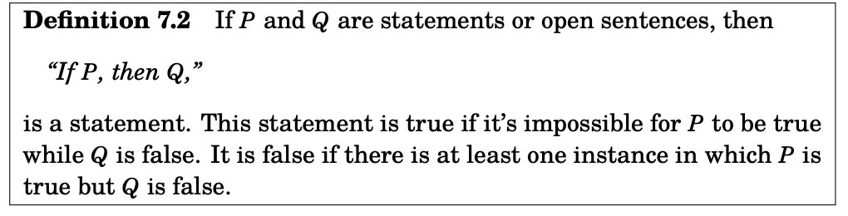
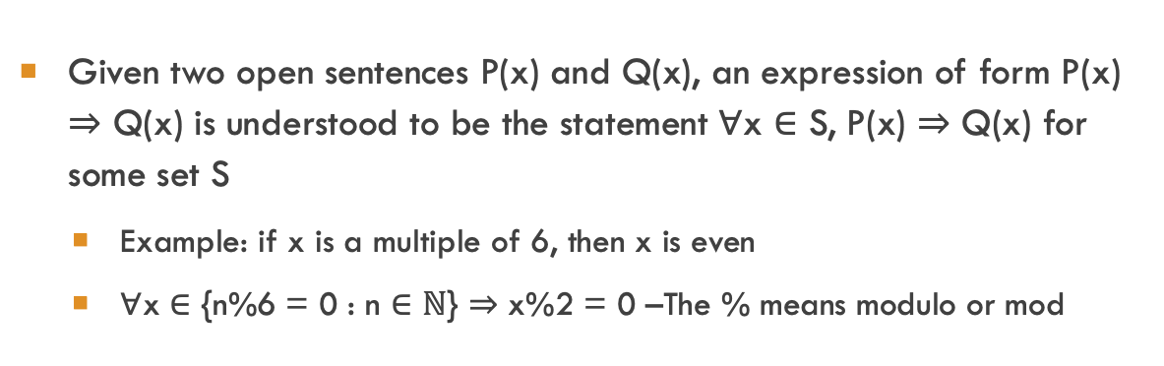
Statements from open sentences
Given two open sentences P(x) and Q(x), an expression of form P(x) ⇒ Q(x) is understood to be the statement ∀x ∈ S, P(x) ⇒ Q(x) for some set S
Example: if x is a multiple of 6, then x is even
∀x ∈ {n%6 = 0 : n $\text{∈}$ℕ} ⇒ x%2 = 0 –The % means modulo or mod
Notes:
Check out those variables x in P(x) and Q(x)

Slide 8
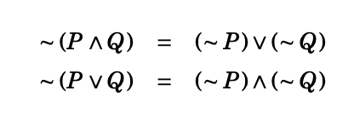
De Morgan’s laws
The ¬ operator negates a statement
One of the well known examples of this is De Morgan’s Laws
The ¬ operator reverses the logic in it. We can prove it with truth tables
We will also later prove it mathematically

Slide 9

Explaining de morgan’s laws

Slide 10

Example of negating logic
R: The numbers x and y are both odd (R: is the statement)
This statement means $(x is odd) ∧ (y is odd)$
so its negation is $¬ ((x is odd) ∧ (y is odd))$ =
$¬ (x is odd) ∨ ¬ (y is odd)$=
$(x is even) ∨ (y is even)$
Therefore the negation of R can be expressed in the following ways:
¬ R : The number x is even or the number y is even.
¬ R : At least one of x and y is even.

Slide 11

Again, the logic of ¬ is not equivalent
Consider negating the following statement
R : The square of every real number is non-negative
Symbolically, R can be expressed as ∀x ∈ R, x 2 ≥ 0, and thus its negation is
$$¬ (∀x ∈ R, x^{2} ≥ 0) =$$
$$∃ x ∈ R, ¬ (x^{2}≥ 0) =$$
∃ x ∈ R, x 2 < 0
In words, this is ∼ R : There exists a real number whose square is negative. Observe that R is true and ∼ R is false. Y

Slide 12
Logical equivalence implications and inferences
Logical Equivalence: Two compound propositions P and Q are logically equivalent if they share the same truth table
Logical Implications: Given P and Q, P logically implies Q when Q has truth value true whenever P has truth value true
Rules of Inference: infer a logical statement from given information
I will release a file with some of the basic rules online.

